Slide 1
Male vs Female Professional Athletes Pay Disparity
Sydney Rudny

Slide 2
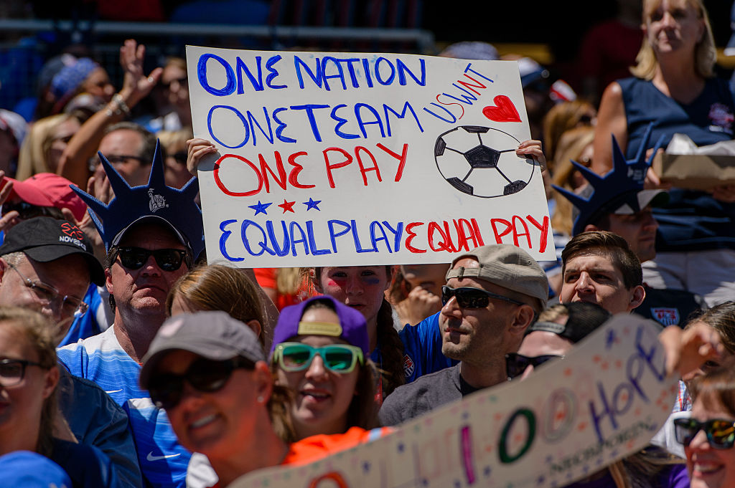
Background
Based on 2018 Census data, white women made $0.79, black women made $0.62, Hispanic women made $0.54, Asian women made $0.90, and American Indian made $0.57 all to the equivalent of $1 of a white man.
USWNT files a lawsuit against US Soccer
Looking at outside factors
Source: https://time.com/5652925/uswnt-equal-pay-negotiations/

Slide 3
Hypothesis
There will be a pay gap between men and women’s sports. While accounting for revenue brought in by the different leagues, the gap between the male and female pay will exist in each sport in favor of the men, however to different degrees.

Slide 4
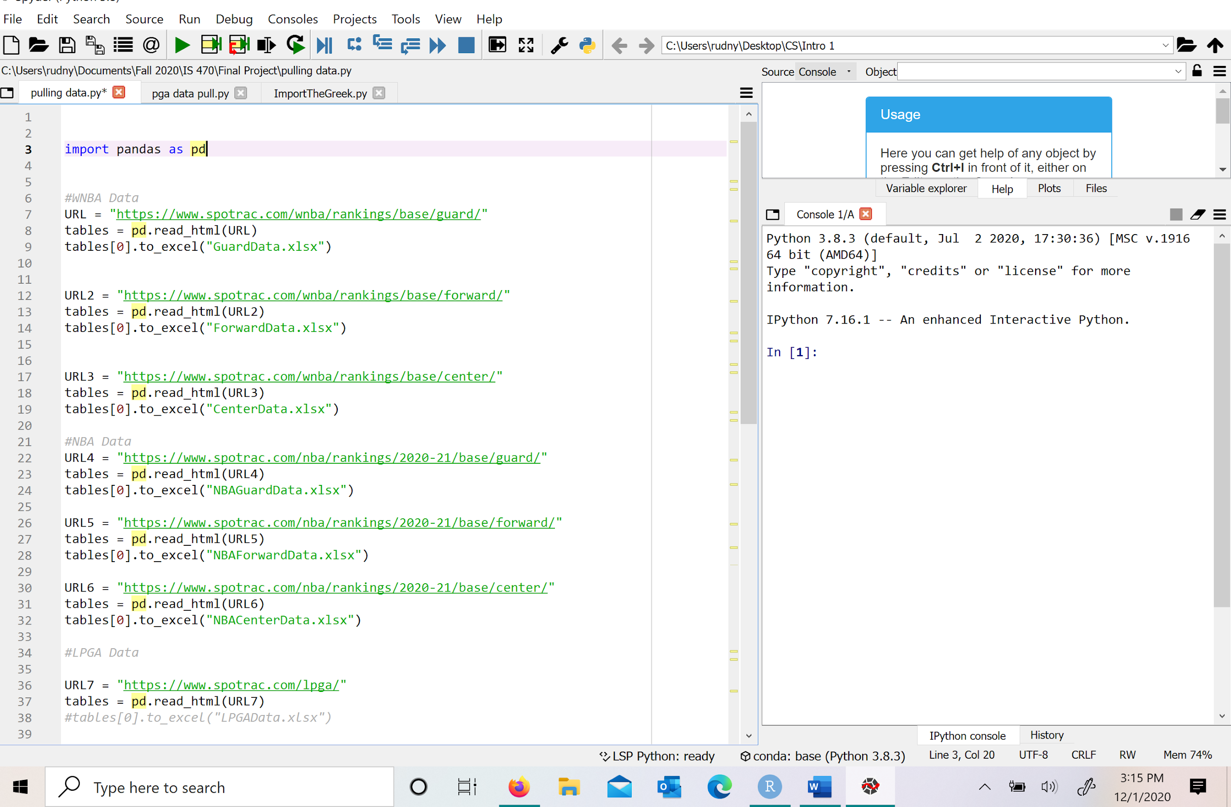
Data Collection
Source: Spotrac.com
Who: NBA, WNBA, WTA, ATP, PGA, and LPGA
Steps: Scrape data from web using Python Cleanse/Filter data in Python Import to Excel Import into R

Slide 5
Data Breakdown
Filtered down to Player Name, Base (salary), League, Position, Sex, Team
WNBA, NBA - Base is one year salary
ATP, WTP - Base is total earnings divided by championships won
PGA - Earnings added over 5 years divided by events played
LPGA - Total earnings divided by events played

Slide 6
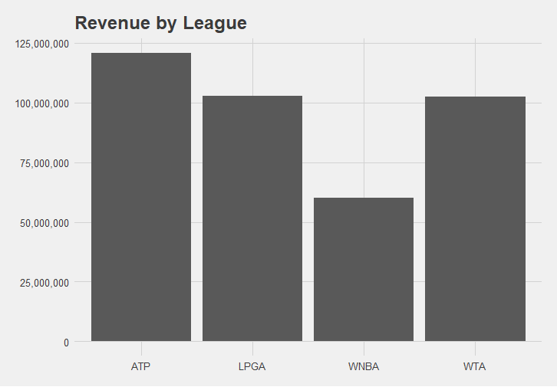
Notes:
WNBA - wsn.com
WTA - causeiq.com
ATP - sportspromedia.com
PGA-thengfq.com

Slide 7
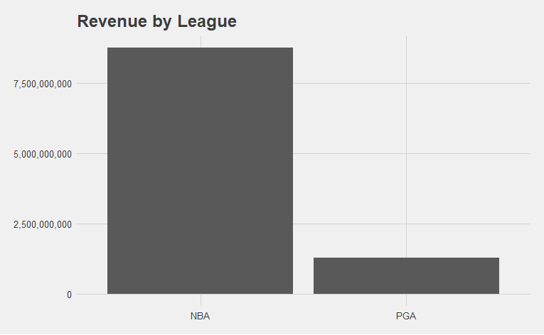
Notes:
NBA 2019-2020- ESPN

Slide 8
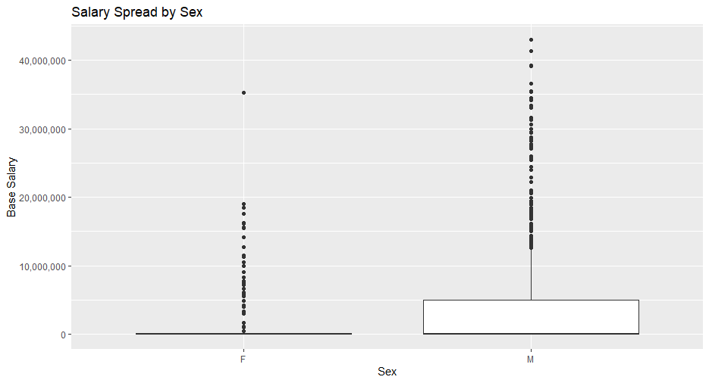
Notes:
Highest Male: Steph Curry
Highest Female Caroline Wozniacki- Tennis

Slide 9
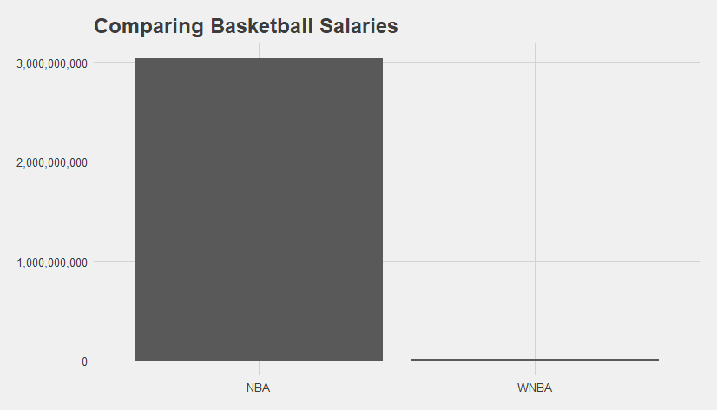

Slide 10
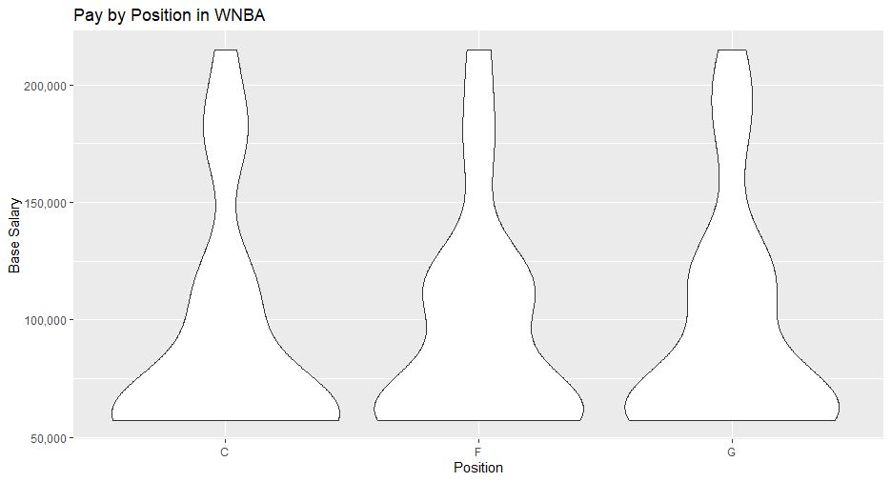

Slide 11
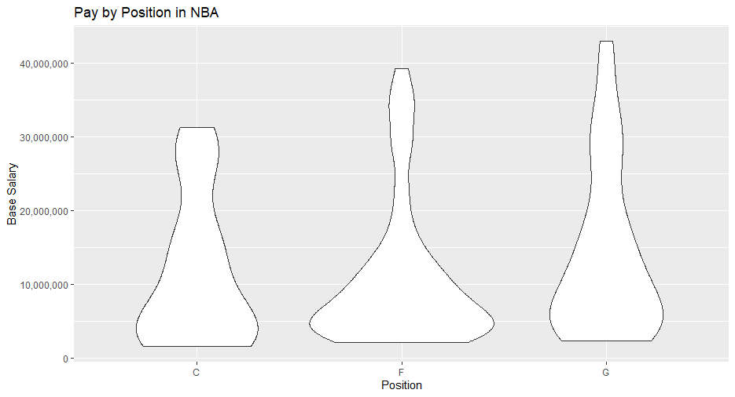

Slide 12
Revenues vs Pay
 | NBA | WNBA
Average Base | $1 | $0.01
WNBA’s revenues are 1% of the NBA’s

Slide 13
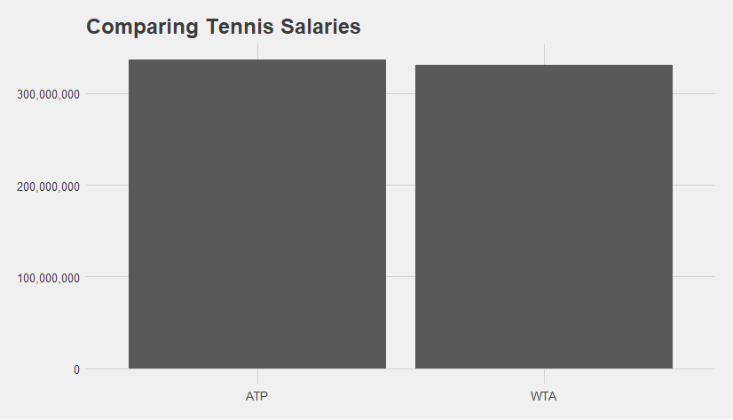

Slide 14
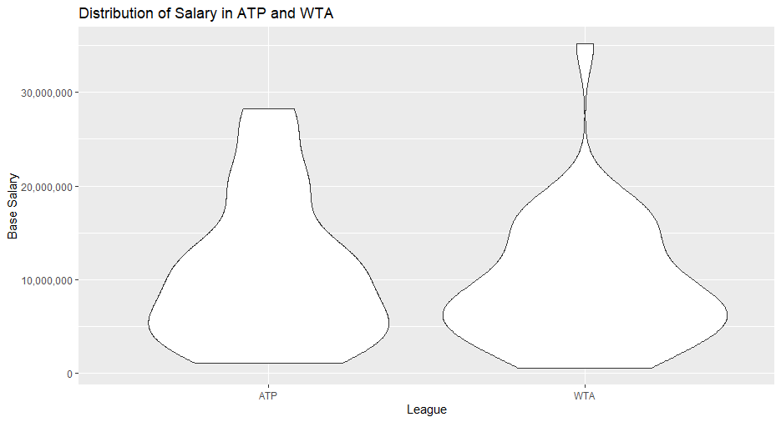

Slide 15
Revenues vs Pay
 | ATP | WTA
Average Base | $1 | $0.87
WTA’s revenues are 84% of the ATP’s

Slide 16
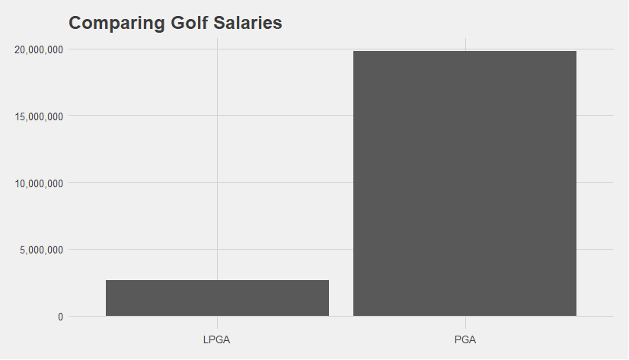

Slide 17
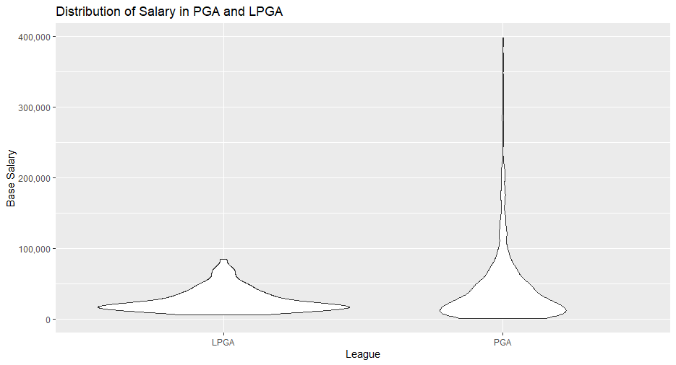

Slide 18
Revenues vs Pay
 | PGA | LPGA
Average Base | $1 | $0.61
LPGA’s revenues are 8% of the PGA’s

Slide 19
Summary of Results
Professional women athletes are paid equally to male counterparts when only comparing base salary to revenues.
Mens’ sports drive more revenue therefore leading to more room for higher salaries
Leagues high paying athletes drive the numbers.

Slide 20
Further action...
Why do we pay athletes so much?
Why does society not highlight women’s sports?
Other gender discriminatory barriers that prevent higher revenues and viewing
Besides salary to revenue, what are other delimiting factors?

Slide 21
Questions?

